Slide 1

Gitam University
BUSINESS CONTRACT VALIDATION
Intel Unnati Training
Team Members :
R. Renu Sree - BU21CSEN0100834
P Pranav Ranga Sai - BU21CSEN0100879
R N Kanaga Sowmiya - BU21CSEN0300475
Indraja S - BU21CSEN0101984
Shaik Muzammil - BU21CSEN0100858

Slide 2

CONTENS
01 - Introduction
02 - Project Motivation
03 - System Architecture
04 - Challenges and Solutions
05 - Conclusion

Slide 3

INTRODUCTION
In the business world, contracts are fundamental to defining the terms and conditions of agreements between parties. Manual validation of these contracts can be time-consuming and prone to errors, leading to potential risks and non-compliance issues. Our project addresses these challenges by providing a solution that leverages advanced technologies to streamline and enhance the contract validation process.

Slide 4

PROJECT MOTIVATION
Why Contract Validation?
Ensures compliance with legal and business standards.
Identifies critical terms and conditions.
Reduces the risk of oversight and errors in manual validation.
Challenges in Manual Validation:
Time-consuming and prone to human error.
It is difficult to maintain consistency across different contracts.
Automation Benefits:
Speeds up the validation process.

Slide 5

SYSTEM ARCHITECTUTRE
Components
Frontend:
React.js:
Role: The front end is responsible for the user interface, allowing users to upload contract files and view the validation results.
Functionality:
Provides forms for file upload.
Displays the parsed data, highlighted clauses, and key entities.
2. Backend:
Flask:
Role: Handles server-side logic, including processing uploaded files and managing requests between the front end and the NLP model.
Functionality:
Receives uploaded contract files and optional templates.
Manages HTTP requests and responses using Axios.
Interfaces with machine learning components to perform text extraction and analysis.

Slide 6


3. NLP Model:
SpaCy:
Role: Performs natural language processing tasks to analyze and extract relevant information from the contract text.
Functionality:
Parses the text to identify and highlight key clauses and entities.
Uses pre-trained models to ensure accuracy and relevance in the identified terms and conditions.
4. Additional Libraries:
PyPDF2:
Role: Extracts text from PDF files to be processed by the NLP model.
Functionality:
Converts PDF content into a text format that can be analyzed.
Ensures compatibility with various document formats.

Slide 7
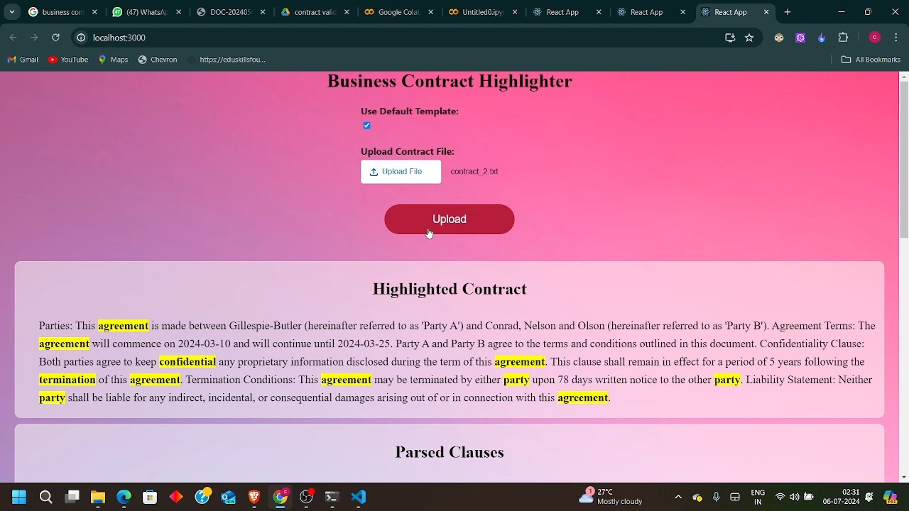
SCREENSHOTS :

Slide 8
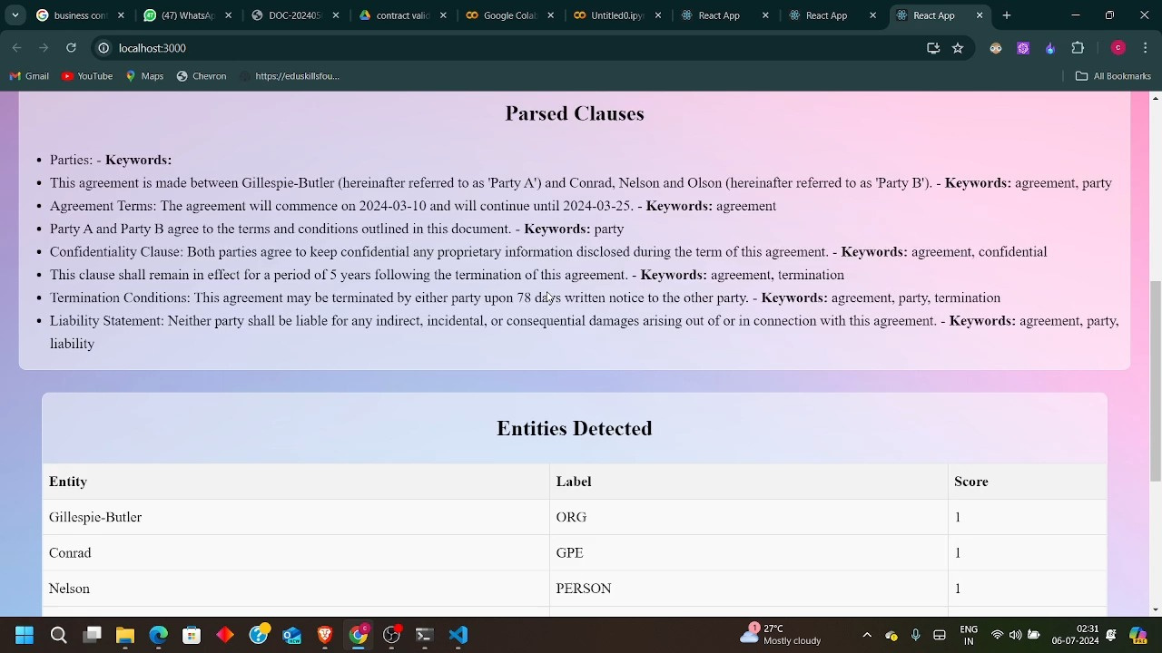

Slide 9
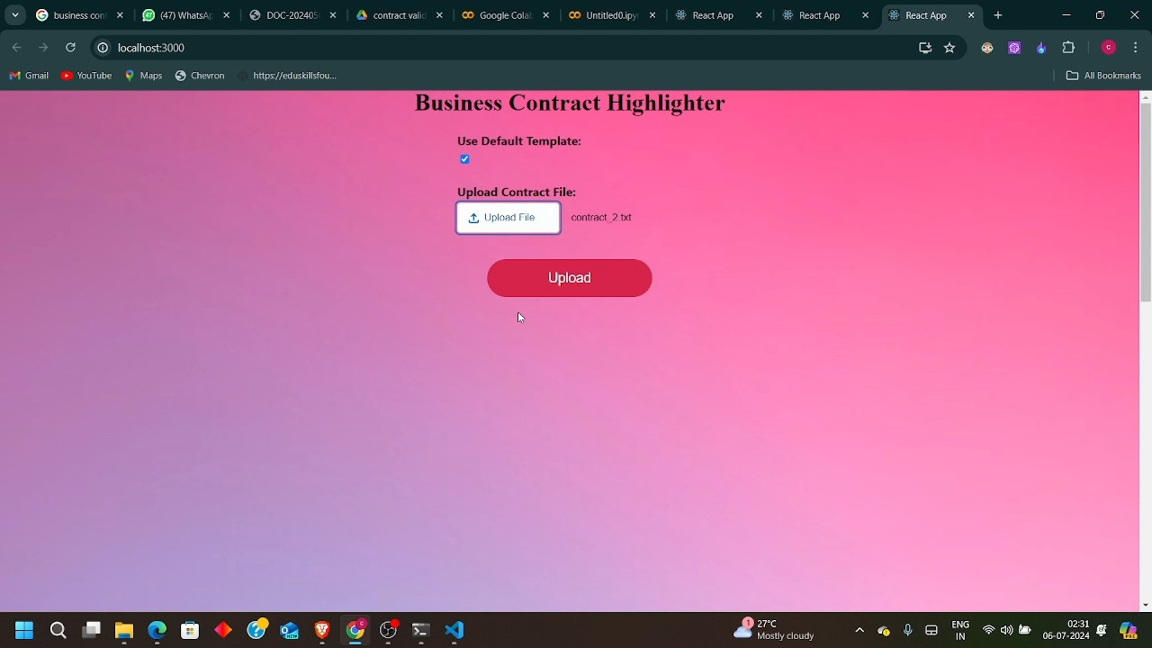

Slide 10

CHALLENGES AND SOLUTION
Common Issues:
Text Extraction: Difficulties in extracting text from complex PDFs.
Entity Recognition: Ensuring high accuracy in detecting entities.
Solutions:
Improved text extraction methods and handling of different file formats.
Fine-tuning the NLP model to enhance entity recognition accuracy.
Additional Features:
Real-time validation feedback.
Customizable templates and keyword lists.

Slide 11


CONCLUSION
Summary:
We have developed an efficient tool for business contract validation.
Leveraged React.js, Flask, and SpaCy for a robust solution.
Demonstrated significant improvements in speed and accuracy.
Impact:
Reduces the time and effort required for contract validation.
Enhances consistency and reliability in identifying key contract elements.
Learnings:
Gained insights into the challenges and solutions in automating contract validation.
Learned the importance of fine-tuning NLP models for specific use cases.

Slide 12
THANK YOU
Team
VANGUARD CREW

